Slide 1
CHAPTER 7 EVOLUTION Descent with modification
Origin of life and evolution of life forms

Slide 2
Pre-test
What is evolution?
Which branch of biology helps in understanding the changes in flora and fauna that have occurred over millions of years on earth?
How the first life form came on earth?
Did life come from outer space?
Explain the Big bang theory
Elaborate origin of earth
Enlist and explain theories of origin of life
Who experimentally proved the theory of chemical evolution of life?
Draw a well labeled diagram of miller’s experimental set up.
Summerise Darwinian theory
Who drew similar conclusions like Darwinian theory about evolution?

Slide 3
EVOLUTION (Descent with modification)
Drew similar conclusions like Darwinian theory
Alfred Wallace
(worked in Malay Archepelago)
Origin of Universe
Origin of Earth
(4.5 billion years ago)
Origin of Life & life forms
(04 billion years back)
Evolution of Life Forms
Natural selection
(Survival of fittest)
Darwinian theory
Lamarckism
Mutation theory of Evolution
(by Hugo de Vries)
Big Bang Theory
Formed solar system in milky way galaxy
Branching descent (Adaptive radiation)
Use and disuse of organs
(Giraffe with long necks as it access leaves on tall trees)
Theory of special creation
Panspermia or cosmozoic theory
Theory of spontaneous generation
Chemical evolution
(Oparin-Haldane Theory)
Spores (units of life) came from outside started life on earth.
Saltation/Single step mutation
3 connotations.
All living organisms (species) that we see, today were created as such.
Diversity was always the same since creation and will be the same in future also.
Earth is about 4000 years old
life came out of decaying and rotting matter (like straw, mud, etc)
Life started from pre-existing non-living organic molecules (e.g. RNA,amino acids protein, etc.) formed from inorganic constituents, under high temperature, volcanic storms, reducing atmosphere containing CH₄, NH₃, etc on earth.
Sudden, random and directionless mutation caused speciation
Disproved by Louis Pasteur by demonstrating that life comes only from pre-existing life.
Shown experimentally by Stanley Loyd Miller in 1953

Slide 4
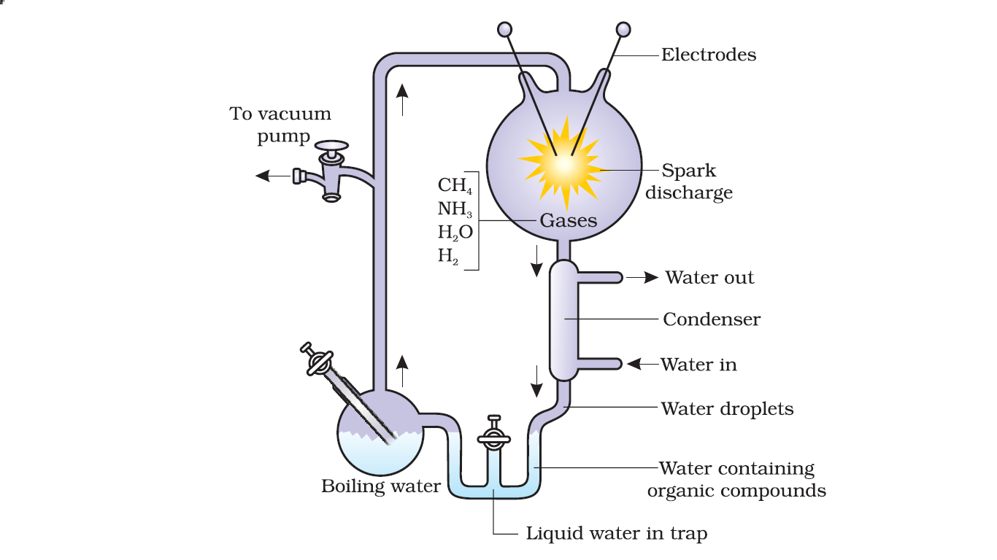
ORIGIN OF LIFE
Stanley Loyd Mille created electric discharge in a closed flask containing CH₄, H₂, NH₃ and water vapour at 800 ºC. He observed formation of amino acids.
Diagrammatic representation of Miller’s experimental setup

Slide 5
Distinguish between Hugo de Vries’s theory and Darwinian theory
Hugo de Vries | Darwinian theory
Mutation caused evolution | Minor inheritable variations caused evolution
Mutations are random and directionless | Variations are small and directional
large difference arising suddenly in a population (SALTATION). | Evolution is gradual

Slide 6
Darwinian theory
Species of organisms inhabiting earth today descended from ancestral species through gradual evolution (Branching descent).
Mechanism of evolution
Survival of fittest; Fitness is the end result of the ability to adapt (based on characteristics which are inherited i.e. there must be a genetic basis for getting selected and to evolve) and get selected by nature.
Natural selection
Branching descent (adaptive radiation)

Slide 7
Evidence supporting evolution by natural selection
Pre-industrailisation (1850s) in England | Post industrialisation (1920) in England
White-coloured lichen covered the trees on which more white-winged moths were survived compared to dark-winged (melanised) moth.
This is due to inability of predators to spot white moth against white background of lichen.
Tree trunks became dark due to industrial smoke and soots. Lichens didn’t grow due to pollution.
Such condition favoured survival of moth by camouflaging themselves.
White-winged moth did not survive due to predators.
This showed that in a mixed population, those that can better-adapt, survive and increase in population size.

Slide 8
Operation of natural selection
Natural selection can lead to (i.e effect of natural selection)
stabilisation (more individuals acquire mean character value),
directional change (more individuals acquire value other than the mean character value) or
disruption (more individuals acquire peripheral character value at both ends of the distribution curve) .

Slide 9
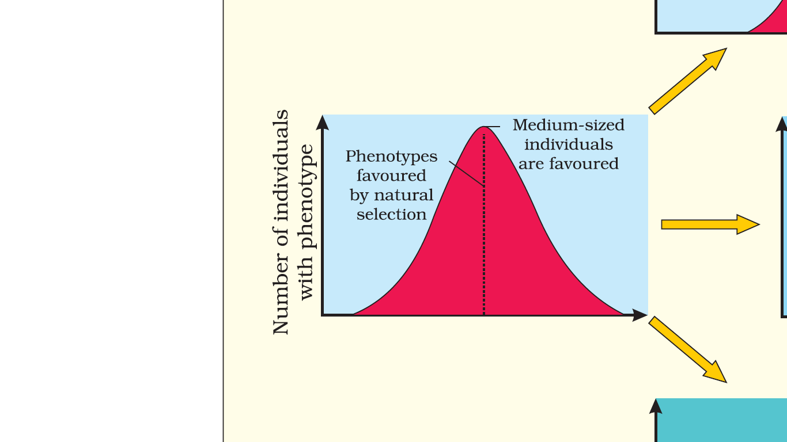
Distribution curve of the operation of natural selection on different traits
Standard distribution of a trait across a population

Slide 10
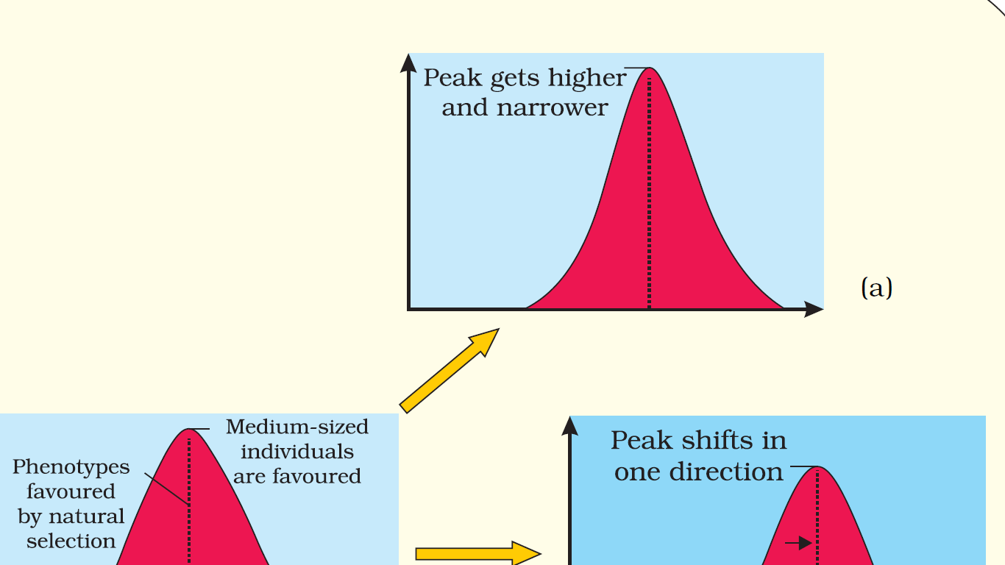
Distribution curve of the operation of natural selection on different traits
Stabilising
(more individuals acquire mean character value)

Slide 11
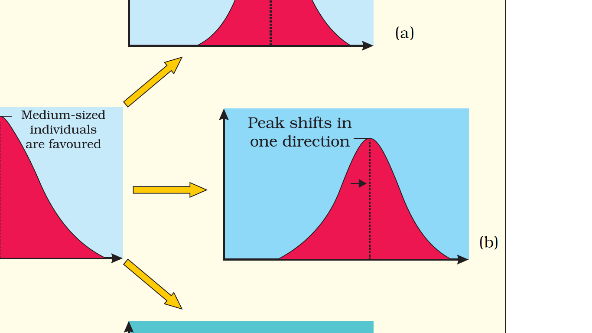
Distribution curve of the operation of natural selection on different traits
Directional
(more individuals acquire value other than the mean character value)

Slide 12
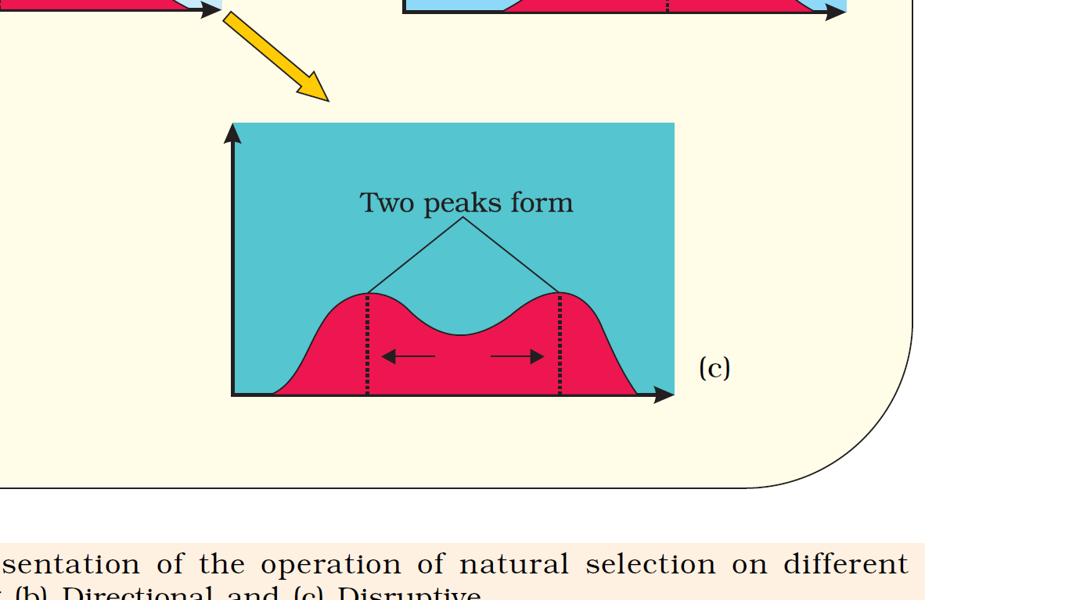
Distribution curve of the operation of natural selection on different traits
Disruptive
(more individuals acquire peripheral character value at both ends of the distribution curve)

Slide 13
HARDY-WEINBERG PRINCIPLE (genetic equilibrium)
Allelic frequency is occurrence of alleles of a gene in a given population.
Allelic frequency of a given population can be calculated mathematically using Hardy-Weinberg equation in algebraic equations.
Hardy-Weinberg principle says that allelic frequencies in a population are stable and is constant from generation to generation OR gene pool remains a constant. This is called genetic equilibrium. [Sum total of all the allelic frequencies is 1. Individual frequencies can be denoted by letter p, q, etc. ]
Gene pool is the total genes and their alleles in a population.
Notes:
Stable = remain same = fixed (Constant)

Slide 14
Alleles of a gene (Height)
T
t

What is allele frequency?

Slide 15
HARDY-WEINBERG PRINCIPLE/EQUATION
Suppose in a diploid organism, frequency of dominant allele (T): p
Frequency of recessive allele (t): q
According to Hardy-Weinberg equation/genetic equilibrium;
p + q = 1 (i.e sum total of all the allelic frequencies is 1)
On squaring both side, (p + q)² = 1
Or
p² + 2pq + q² = 1 (i.e algebraic equations)
Where; p² = Homozygous dominant
2pq = Heterozygous
q² = Homozygous recessive
Disturbance in genetic equilibrium or Hardy-Weinberg equilibrium result in evolution i.e p + q ≠ 1 result in evolution.
Notes:
In a diploid organism, p and q represent the frequency of allele A and allele a.
The frequency of AA individuals in a population is simply p². i.e., the probability that an allele A with a frequency of p appear on both the chromosomes of a diploid individual is simply the product of the probabilities.
Similarly, of aa is q² and of Aa is 2pq.
Hence, p²+2pq+q²=1. This is a binomial expansion of (p+q)².
When frequency measured, differs from expected values, the difference (direction) indicates the extent of evolutionary change.
Disturbance in genetic equilibrium or Hardy-Weinberg equilibrium, i.e. change of frequency of alleles in a population would then be interpreted as resulting in evolution.

Slide 16
Hardy-Weinberg Principle
Five factors affecting Hardy-Weinberg equilibrium are;
gene migration or gene flow
genetic drift
mutation
genetic recombination
natural selection.

Slide 17
Factors Affecting Hardy-Weinberg Principle
Migration of a section of population (founders) to a new place
Addition of new genes/alleles
Change in gene frequencies
Founder effect
New population occurs
Gene flow is occurrence of multiple gene migration.
Genetic drift is change in gene frequencies by chance
Original drifted population becomes founders
Founder effect: speciation due to drastic change in allele frequency
Notes:
When migration of a section of population to another place and population occurs, gene frequencies change in the original as well as in the new population.
New genes/alleles are added to the new population and these are lost from the old population (i.e gene flow).
Gene flow is occurrence of multiple gene migration.
If the gene frequencies change occurs by chance, it is called genetic drift.
Sometimes the change in allele frequency is so different in the new sample of population that they become a different species. The original drifted population becomes founders and the effect is called founder effect.

Slide 18
What are the evidences for evolution?
Paleontological evidences
Comparative morphological and anatomical evidences
Biochemical evidences
Biogeographical evidences
Embryological evidences

Slide 19
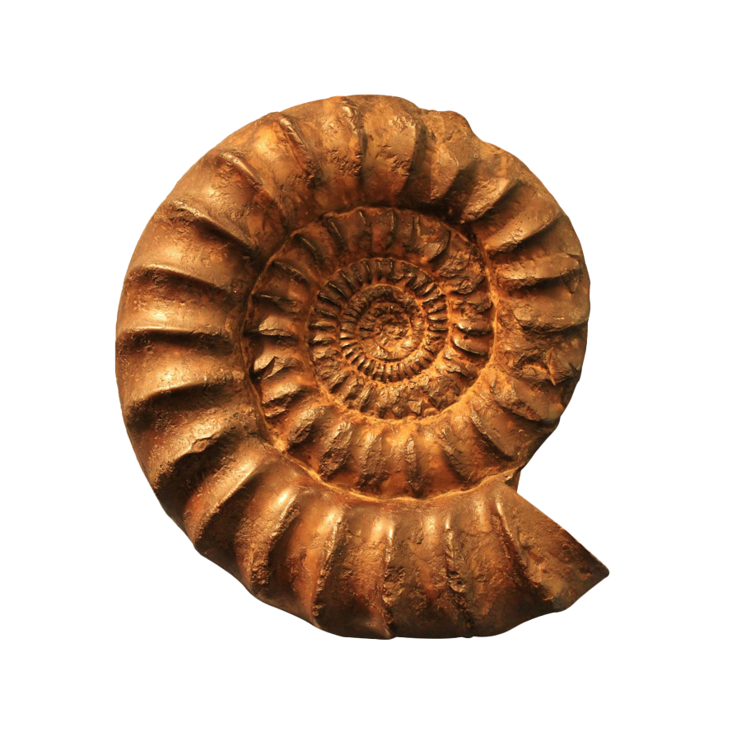
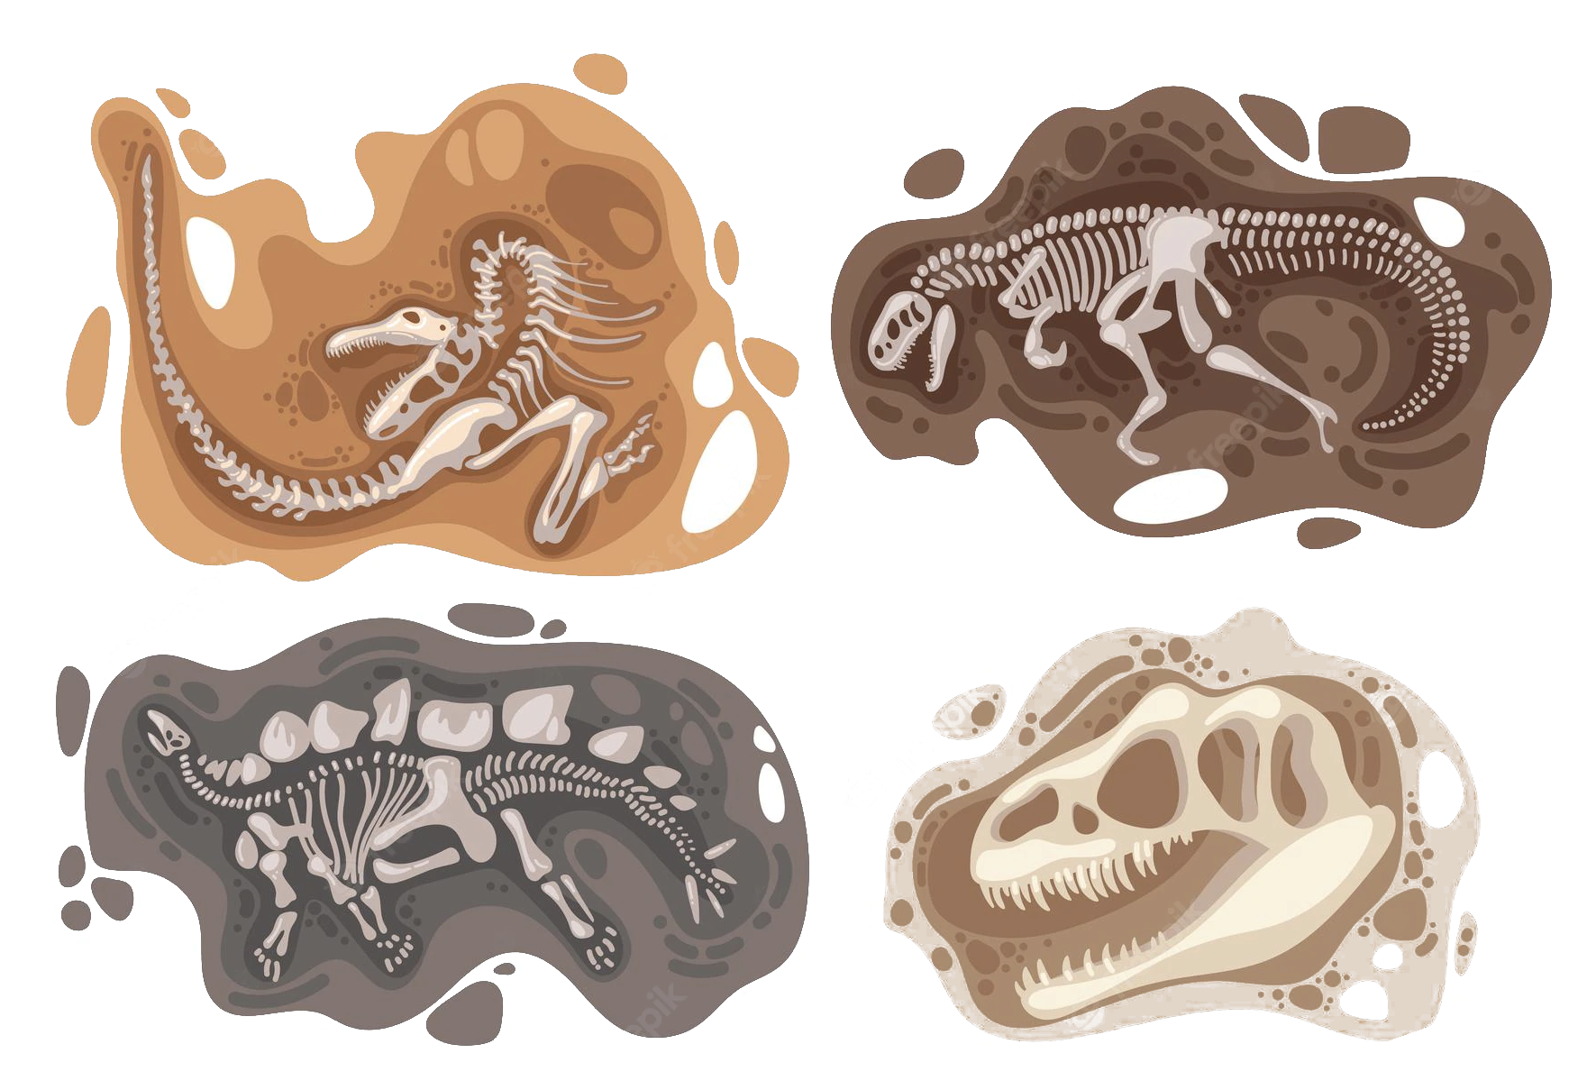
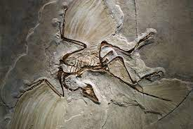
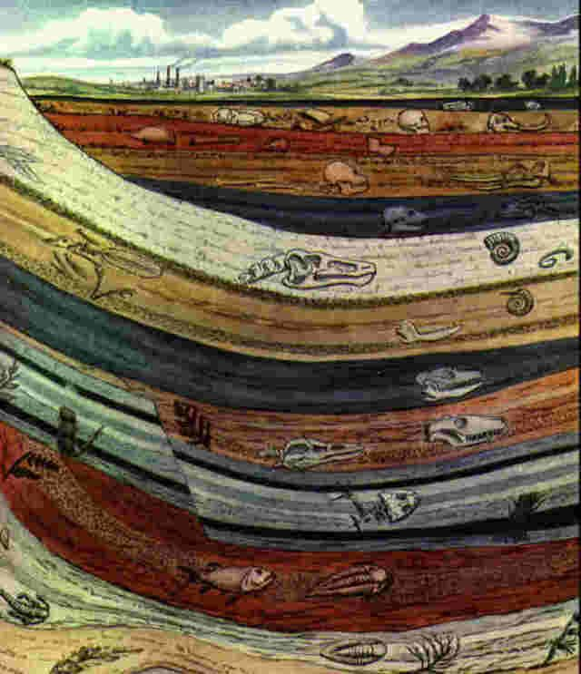
Paleontological evidences
Fossils are remains or impression of hard parts of life-forms found in rocks.
Rocks form sediments and these are arranged one over the other during the long history of earth to form different layers of earth's crust.
Different-aged rock sediments contain fossils of different life-forms who probably died during the formation of the particular sediment.
Some of fossils appear similar to modern organisms.
Some fossil remains represent extinct organisms (e.g., Dinosaurs).
A study of fossils in different sedimentary layers indicates the geological period in which they existed.
By studying different sedimentary layers, geological time-spans in which the organisms lived can be predicted.

Slide 20
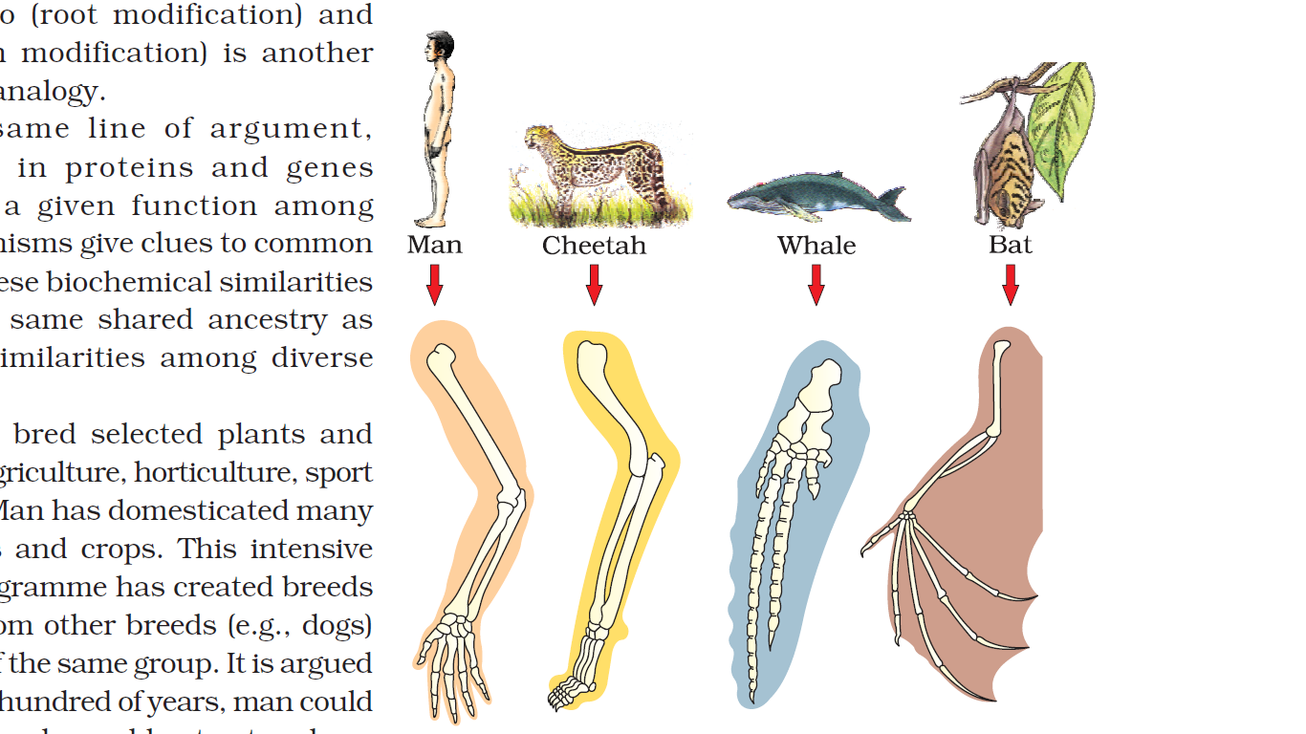
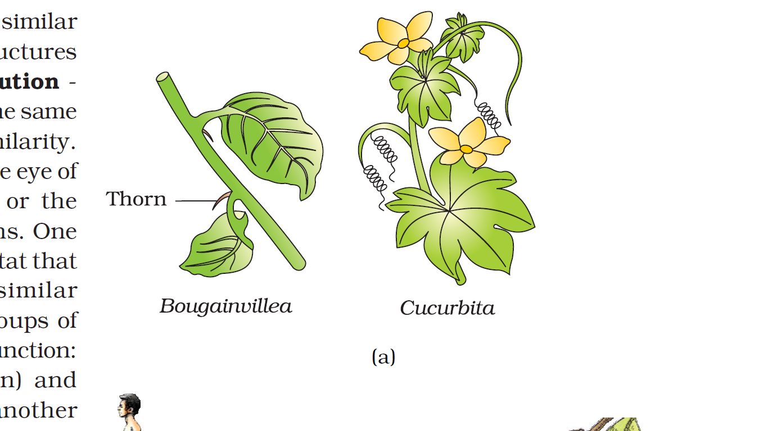
Comparative Anatomical And Morphological as an evidence for Evolution
Homologous structures are those structures which are anatomically/structurally similar, but have different functions.
Example for Homologous structures;
forelimbs of whales, bats, Cheetah and human (all mammals). Though forelimbs perform different functions in whales, bats, Cheetah and human, they have similar anatomical structure –all of them have humerus, radius, ulna, carpals, metacarpals and phalanges in their forelimbs.
The thorn of Bougainvillea and tendrils of Cucurbita (plants)
Hearts and brains in vertebrates.
Homology indicates common ancestry.
Homologous structures are a result of divergent evolution
Tendril

Slide 21
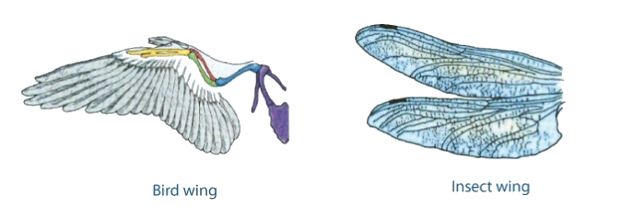
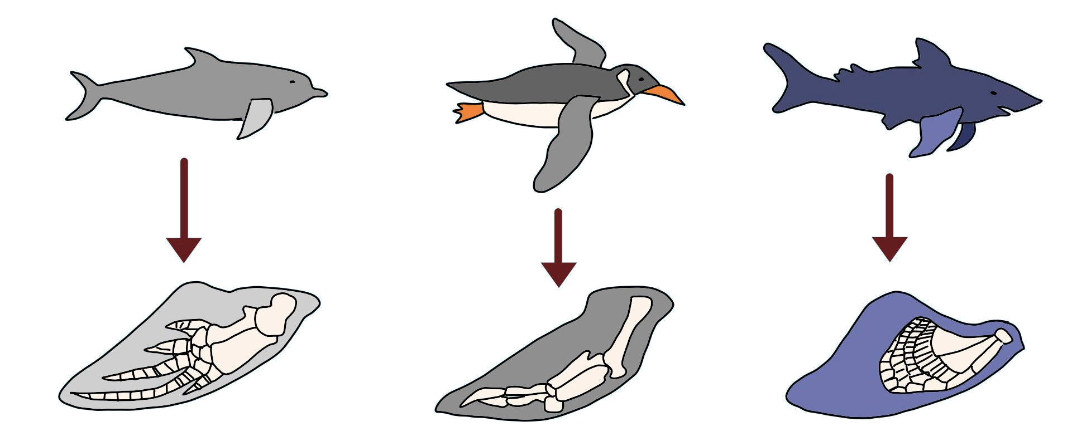
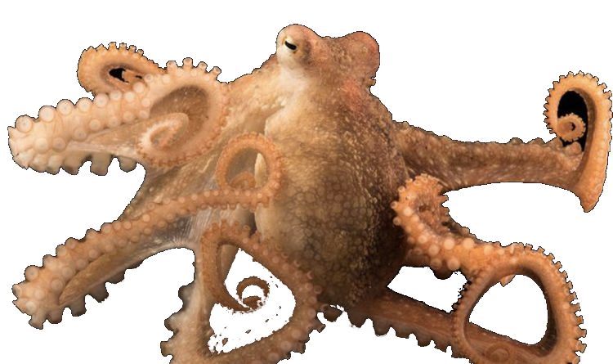
Comparative Anatomical And Morphological as an evidence for Evolution
Analogous structures are those structures which are anatomically different structures though they perform similar functions.
Analogous structures are a result of convergent evolution
Examples of analogous structures;
Wings of butterfly and birds are different structures evolving for the same function.
Eyes of the octopus and of mammals
flippers of Penguins and Dolphins
Sweet potato and potato.
Similar habitat that has resulted in selection of similar adaptive features in different groups of organisms, but toward the same function
*Analogy: opposite to homology

Slide 22
Biochemical evidences
Biochemical similarities in diverse organisms shows same shared ancestry.
Similarities in proteins and genes performing same function among diverse organisms give clues to common ancestry.

Slide 23
Biogeographical evidences
Species restricted to a region develop unique features.
Species present in widely separated regions show similarity of ancestry.

Slide 24
Examples of evolution by anthropogenic action
Excess use of herbicides, pesticides, etc., has resulted in natural selection of resistant varieties in a much lesser time scale.
Microbes against which we employ antibiotics or drugs become resistant organisms and they appear in months or years.
These examples tells us that evolution is a stochastic process based on chance events in nature and chance mutation in the organisms, not a direct process .

Slide 25
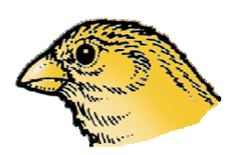
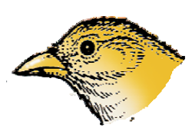
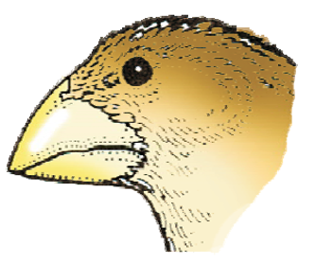
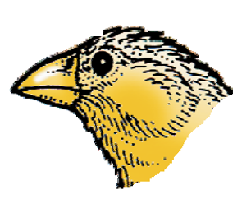
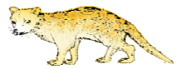
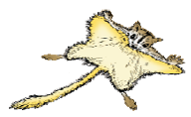
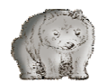
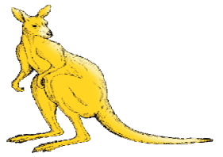

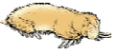
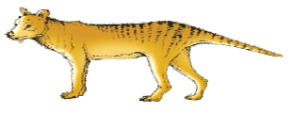
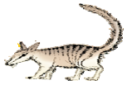
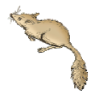

Adaptive Radiation
The process of evolution of different species in a given geographical area starting from a point and literally radiating to other areas of geography (habitats) is called adaptive radiation.
For example;
Darwin’s finches
Charles Darwin observed an amazing diversity of small black birds (later called Darwin’s Finches) in Galapagos Islands.
All these varieties evolved on the island itself. From the original seed-eating features, many other forms with altered beaks arose, enabling them to become insectivorous and vegetarian finches.
Australian marsupials.
Different marsupials were evolved from an ancestral stock within the Australian island continent.
Placental animals in Australia
Variety of placental mammals have evolved which appear similar to a corresponding marsupials
Variety of beaks of finches that Darwin found in Galapagos Island
Tiger cat
Sugar glider
Wombat
Marsupial mole
Tasmanian wolf
Koala
Bandicoot
Marsupial rat
Kangaroo
Banded Anteater

Slide 26
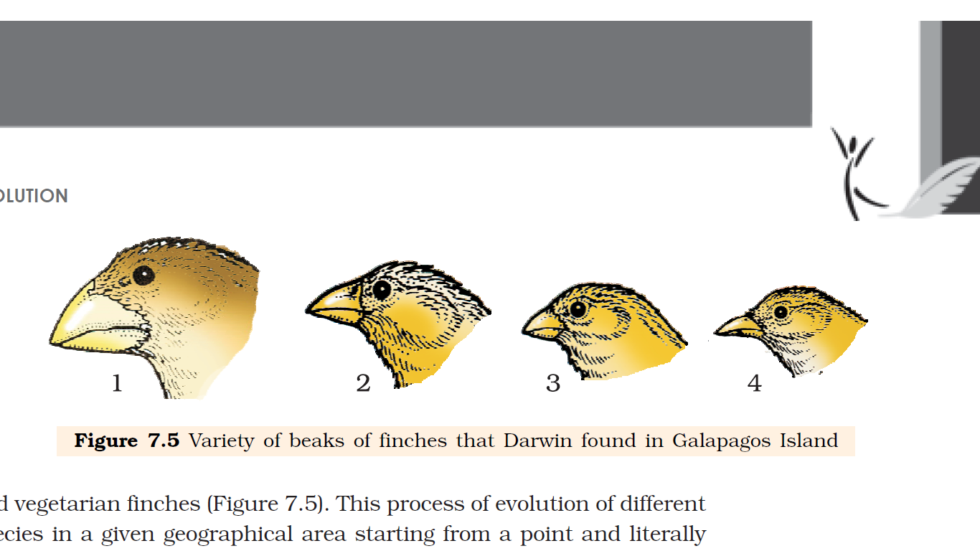
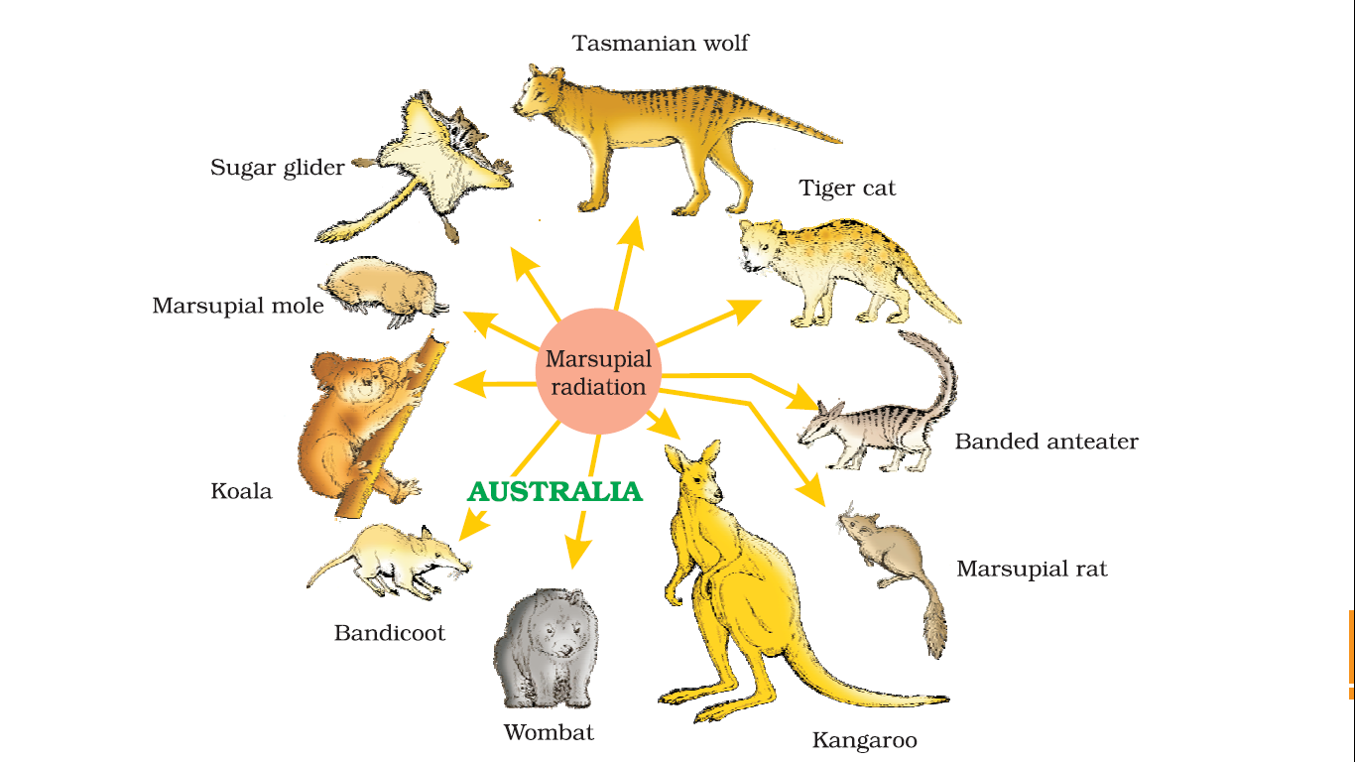
Examples of adaptive radiation
Variety of beaks of finches that Darwin found in Galapagos Island
Adaptive radiation of marsupials of Australia

Slide 27
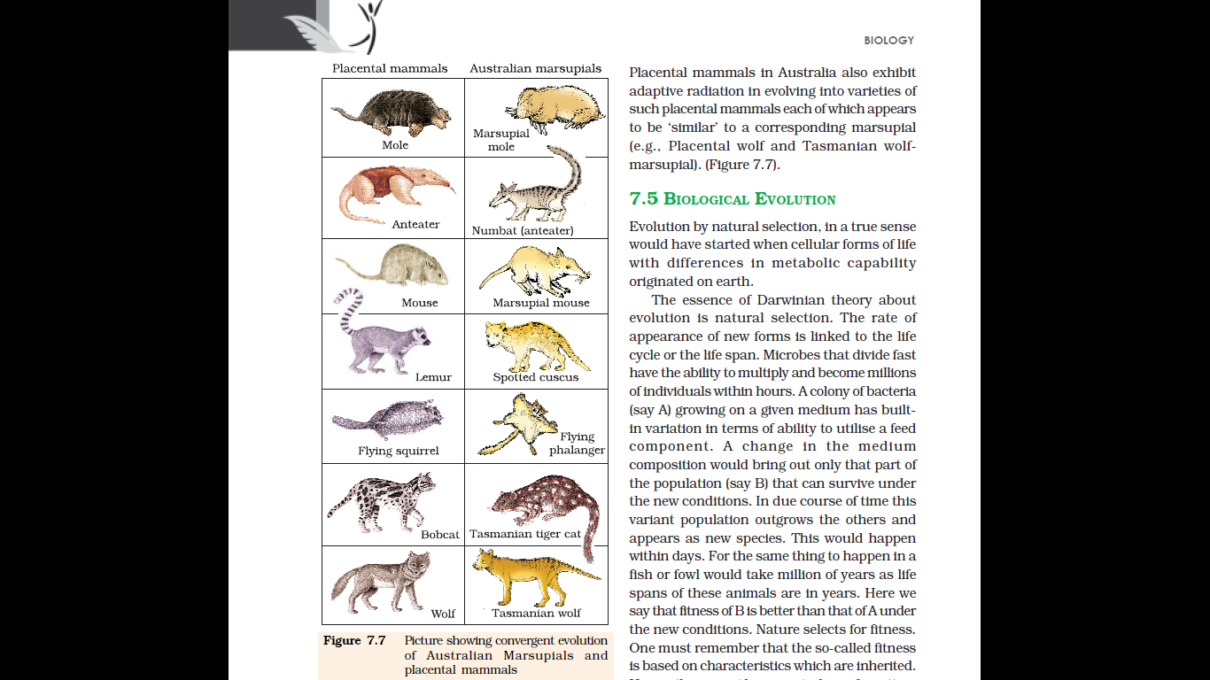
Convergent evolution
When more than one adaptive radiation appeared to have occurred in an isolated geographical area (representing different habitats), this can be called as convergent evolution.
Various placental mammals in Australia have undergone convergent evolution along with Australian marsupials. The placental mammals of Australia appears to be ‘similar’ to a corresponding marsupial.
Example; Placental wolf and Tasmanian wolf marsupial
Convergent evolution of Australian Marsupials and placental mammals

Slide 28
BIOLOGICAL EVOLUTION
Evolution by natural selection would have started since the origination of different cellular forms having different metabolic capability.
Jean Baptiste Lamarck, French naturalist had said that evolution of life forms had occurred but driven by use and disuse of organs.
Lamarck gave the examples of Giraffes who in an attempt to forage leaves on tall trees had to adapt by elongation of their necks. As they passed on this acquired character of elongated neck to succeeding generations, Giraffes, slowly, over the years, came to acquire long necks.
Nobody believes this conjecture any more.
The two key concepts of Darwinian Theory of Evolution;
Branching descent and
Natural selection
Notes:
Evolution by natural selection would have started when cellular forms of life with differences in metabolic capability originated on earth.
The essence of Darwinian theory about evolution is natural selection.
The rate of appearance of new forms is linked to the life cycle or the life span. Microbes that divide fast have the ability to multiply and become millions of individuals within hours. A colony of bacteria (say A) growing on a given medium has built in variation in terms of ability to utilise a feed component. A change in the medium composition would bring out only that part of the population (say B) that can survive under the new conditions. In due course of time this variant population outgrows the others and appears as new species. This would happen within days.
For the same thing to happen in a fish or fowl would take million of years as life spans of these animals are in years. Here we say that fitness of B is better than that of A under the new conditions. Nature selects for fitness. One must remember that the so-called fitness is based on characteristics which are inherited. Hence, there must be a genetic basis for getting selected and to evolve. Another way of saying the same thing is that some organisms are better adapted to survive in an otherwise hostile environment. Adaptive ability is inherited. It has a genetic basis. Fitness is the end result of the ability to adapt and get selected by nature.
Branching descent and natural selection are the two key concepts of Darwinian Theory of Evolution (Figures 7.7 and 7.8).
Even before Darwin, a French naturalist Lamarck had said that evolution of life forms had occurred but driven by use and disuse of organs. He gave the examples of Giraffes who in an attempt to forage

Slide 29
BIOLOGICAL EVOLUTION
Read the 3rd para in page 135 and answer the following
State the novelty and brilliant insight of Darwin work of evolution
Notes:
Natural selection is based on certain observations which are factual. For example, natural resources are limited, populations are stable in size except for seasonal fluctuation, members of a population vary in characteristics (infact no two individuals are alike) even though they look superficially similar, most of variations are inherited etc. The fact that theoretically population size will grow exponentially if everybody reproduced maximally and the fact that population sizes in reality are limited, means that there had been competition for resources. Only some survived and grew at the cost of others that could not flourish.
The novelty and brilliant insight of Darwin was this: he asserted that variations, which are heritable and which make resource utilisation better for few (adapted to habitat better) will enable only those to reproduce and leave more progeny. Hence for a period of time, over many generations, survivors will leave more progeny and there would be a change in population characteristic and hence new forms appear to arise.

Slide 30
BIOLOGICAL EVOLUTION
It is possible that the work of Thomas Malthus on populations influenced Darwin.
In 1798, Thomas Malthus (1766 to 1834) published the Principle of Population where he made the observations that the human race would be likely to overproduce if the population size was not kept under control.
Natural selection is based on certain observations which are factual. For example,
natural resources are limited, populations are stable in size except for seasonal fluctuation,
members of a population vary in characteristics (in fact no two individuals are alike) even though they look superficially similar,
most of variations are inherited etc.
The novelty and brilliant insight of Darwin was:
he asserted that inheritable variations which make resource utilisation better will enable only those to reproduce and leave more progeny.
Hence for a period of time, over many generations, survivors will leave more progeny and there would be a change in population characteristic and hence new forms appear to arise.
Notes:
Natural selection is based on certain observations which are factual. For example, natural resources are limited, populations are stable in size except for seasonal fluctuation, members of a population vary in characteristics (infact no two individuals are alike) even though they look superficially similar, most of variations are inherited etc.
Theoretically,
population size will grow exponentially, if everybody reproduced maximally and
population sizes in reality are limited, means that there had been competition for resources.
Only some survived and grew at the cost of others that could not flourish.
The novelty and brilliant insight of Darwin was this: he asserted that variations, which are heritable and which make resource utilisation better for few (adapted to habitat better) will enable only those to reproduce and leave more progeny. Hence for a period of time, over many generations, survivors will leave more progeny and there would be a change in population characteristic and hence new forms appear to arise.

Slide 31
Mechanism Of Evolution
What is the origin of variation among living forms and how does speciation occur?
Even though Mendel had talked of inheritable 'factors' influencing phenotype, Darwin either ignored these observations or kept silence.
Hugo de Vries based on his work on evening primrose brought forth the idea of mutations – large difference arising suddenly in a population.
Hugo deVries believed mutation caused speciation and hence called it saltation (single step large mutation).
Studies in population genetics, later, brought out some clarity.
Notes:
Natural selection is based on certain observations which are factual. For example, natural resources are limited, populations are stable in size except for seasonal fluctuation, members of a population vary in characteristics (infact no two individuals are alike) even though they look superficially similar, most of variations are inherited etc. The fact that theoretically population size will grow exponentially if everybody reproduced maximally and the fact that population sizes in reality are limited, means that there had been competition for resources. Only some survived and grew at the cost of others that could not flourish.
The novelty and brilliant insight of Darwin was this: he asserted that variations, which are heritable and which make resource utilisation better for few (adapted to habitat better) will enable only those to reproduce and leave more progeny. Hence for a period of time, over many generations, survivors will leave more progeny and there would be a change in population characteristic and hence new forms appear to arise.

Slide 32
Hugo de Vries v/s Darwinian theory
Accoring to Hugo deVries | Darwinian theory
Mutation caused evolution | Minor inheritable variations caused evolution
Mutations are random and directionless | Variations are small and directional
large difference arising suddenly in a population. | Evolution is gradual

Slide 33
A Brief Account Of Evolution
Sea weeds and few plants existed
Dinosaurs suddenly disappeared
Formation of active invertebrates
Million years ago | 2000 | 500 | 350 | 320 | 200 | 65
Reptiles dominated the earth (Example Tyrannosaurus rex).
Reptiles went back into water to evolve into fish like reptiles (e.g. Ichthyosaurs,)
First cellular forms of life appeared
Jawless fish probably evolved.
Fish with stout and strong fins could move on land and go back to water.

Slide 34
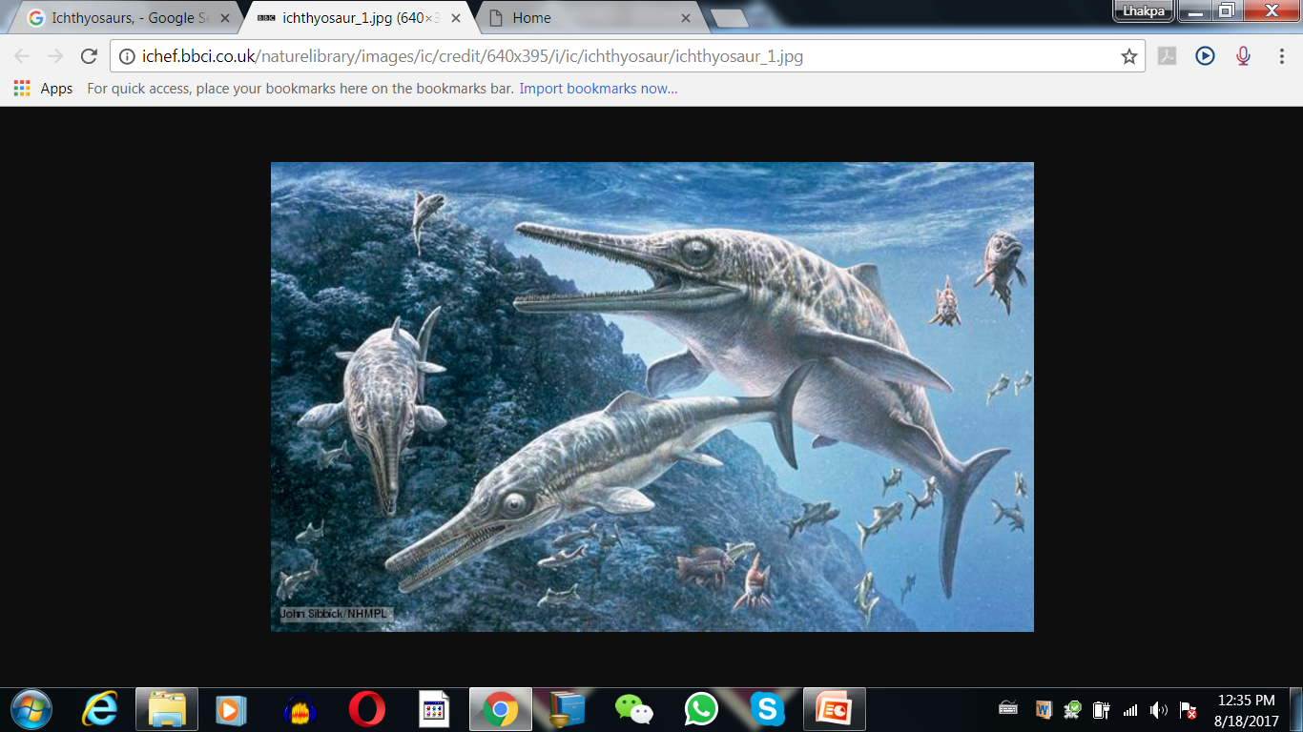
Ichthyosaurs

Slide 35
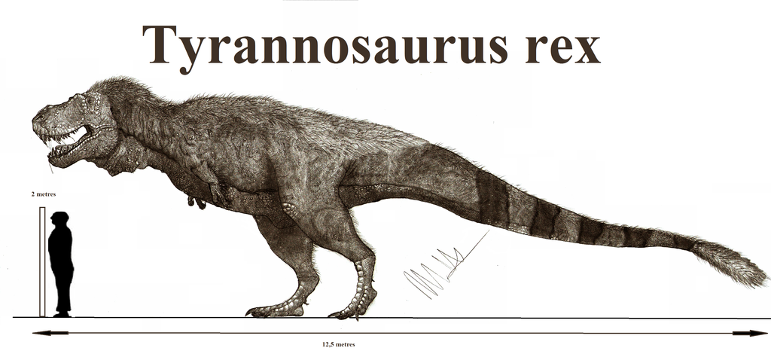
Tyrannosaurus rex was about 20 feet in height
Had huge fearsome dagger like teeth

Slide 36
Why did all dinosaurs become extinct?
Disappearance of dinosaurs may be due to;
Some say climatic changes killed them.
Some say most of them evolved into birds.

Slide 37
How non-cellular macromolecules could evolved into membranous cells?
The mechanism of how non-cellular aggregates of giant macromolecules could evolve into cells with membranous envelop is not known.
Some of these cells had the ability to release O₂.
The reaction could have been similar to the light reaction in photosynthesis where water is split with the help of solar energy captured and channelised by appropriate light harvesting pigments.
Slowly single-celled organisms became multi-cellular life forms.

Slide 38
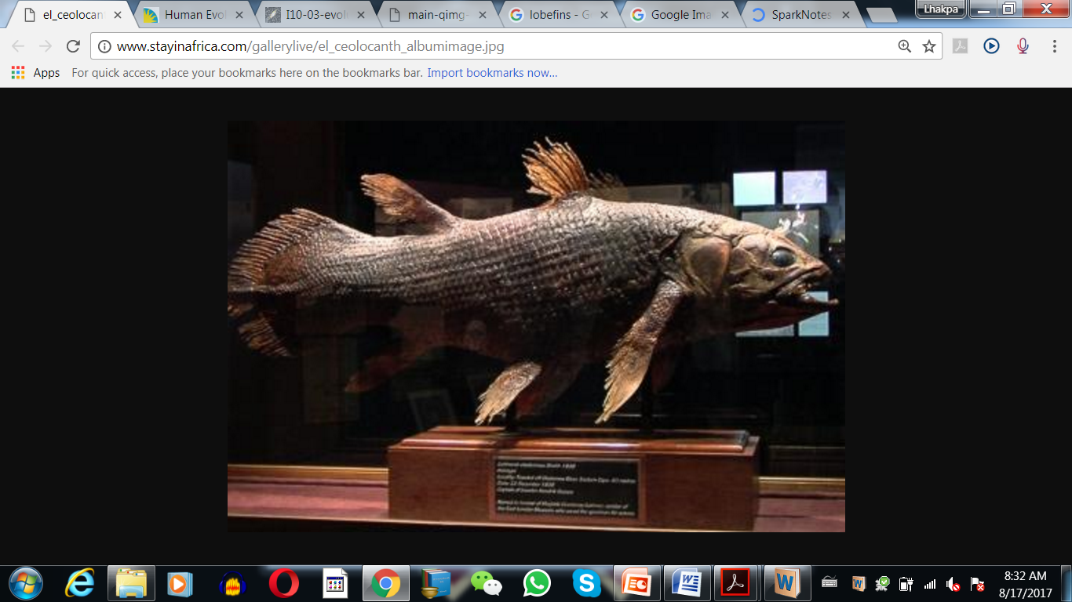
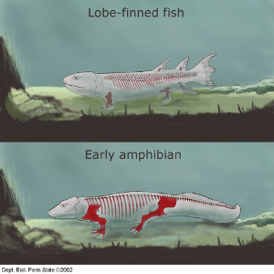
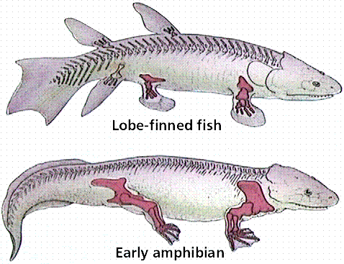
Coelacanth- a lobefins
In 1938, Coelacanth (a fish) was caught in South Africa was thought to be extinct.
lobefins were the first amphibians and ancestors of modern day frogs and salamanders.
The amphibians evolved into reptiles. They lay thick shelled eggs which do not dry up in sun unlike those of amphibians.
Gradually, turtles, tortoises and crocodiles were evolved.

Slide 39
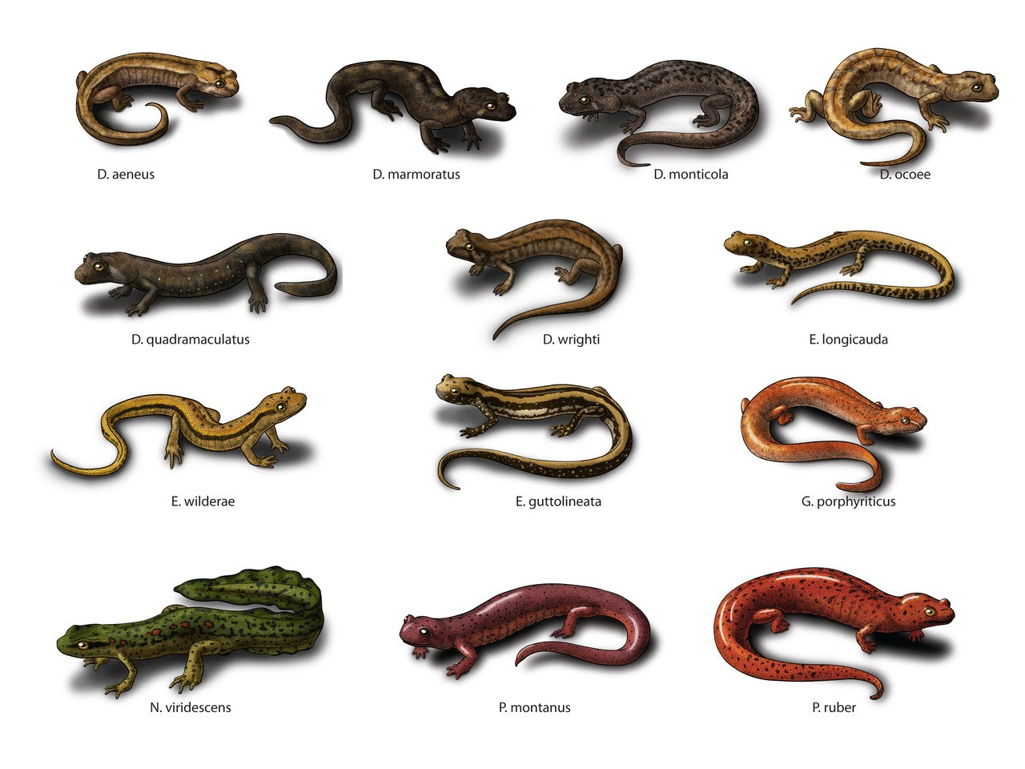
Salamanders

Slide 40
A BRIEF ACCOUNT OF EVOLUTION
The first mammals were like shrews. Their fossils are small sized.
Mammals were viviparous and protected their unborn young inside the mother’s body.
Mammals were more intelligent in sensing and avoiding danger at least.
When reptiles came down mammals took over this earth.
There were in South America mammals resembling horse, hippopotamus, bear, rabbit, etc.
Due to continental drift, when South America joined North America, these animals were overridden by North American fauna.
Due to the same continental drift pouched mammals of Australia survived because of lack of competition from any other mammal.
Some mammals live wholly in water. Example; Whales, dolphins, seals and sea cows.
Evolution of horse, elephant, dog, etc., are special stories of evolution.
The most successful story is the evolution of man with language skills and self-consciousness.

Slide 41
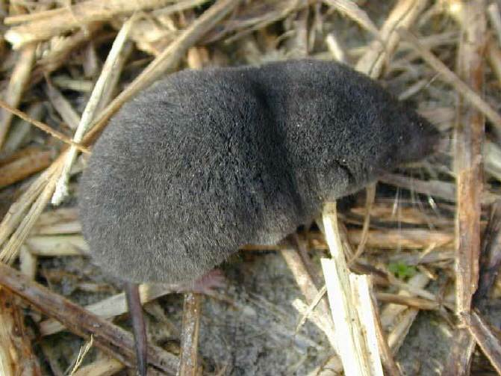
Shrews

Slide 42
ORIGIN AND EVOLUTION OF MAN
Time of origin | Human ancestors | General features/Facts
15 mya | Dryopithecus | hairy and walked like gorillas and chimpanzees, more ape-like
15 mya | Ramapithecus | hairy and walked like gorillas and chimpanzees, more man-like
2 mya | Australopithecines | probably lived in East African grasslands, hunted with stone weapons but essentially ate fruit
 | Homo habilis | first human-like being the hominid, brain capacities were between 650-800cc, probably did not eat meat
1.5 mya | Homo erectus (Java man) | large brain around 900cc, ate meat
1,00,000- 40,000 years back | Neanderthal man | Brain size of 1400cc, lived in near east and central Asia. They used hides to protect their body and buried their dead.
75,000-10,000 years ago (ice age) | Homo sapiens (Modern man) | Arose in Africa and moved across continents and developed into distinct races

Slide 43
EVOLUTION OF MAN
Few fossils of man-like bones have been discovered in Ethiopia and Tanzania revealed hominid features. These fossils lead to the belief that about 3-4 mya, man-like primates walked in eastern Africa.
They were probably smaller than 4 feet but walked up right.
Pre-historic cave art developed about 18,000 years ago.
Agriculture came around 10,000 years back and human settlements started.

Slide 44
Introduction
Evolutionary Biology is the study of history of life forms on earth.
Notes:
In RNA, every nucleotide residue has an additional –OH group present at 2' -position in the ribose.
Also, in RNA the uracil is found at the place of thymine (5-methyl uracil, another chemical name for thymine).

Slide 45
ORIGIN OF UNIVERSE
SOME FACTS
The universe is almost 20 billion years old.
Earth is almost a speck in the universe.
Huge clusters of galaxies comprise the universe.
Galaxies contain stars and clouds of gas and dust.
The Big Bang theory
Explain the origin of universe.
It talks of a singular huge explosion. The universe expanded and hence, the temperature came down. Hydrogen and Helium formed sometime later. The gases condensed under gravitation and formed the galaxies of the present day universe.

Slide 46
ORIGIN OF EARTH
In the solar system of the milky way galaxy, earth was supposed to have been formed about 4.5 billion years back.
There was no atmosphere on early earth.
Water vapour, methane, carbondioxide and ammonia released from molten mass covered the surface.
The UV rays from the sun broke up water into Hydrogen and Oxygen and the lighter H₂ escaped.
Oxygen combined with ammonia and methane to form water, CO₂, O₃and others.
The ozone layer was formed.
As it cooled, the water vapour fell as rain, to fill all the depressions and form oceans.
Life appeared 500 million years after the formation of earth, i.e., almost four billion years back.

Slide 47
ORIGIN OF LIFE
Theory of panspermia / cosmozoic theory
Some scientists believed that spores came from outside started life on earth.
Early Greek thinkers thought units of life called spores were transferred to different planets including earth.
‘Panspermia’ is still a favourite idea for some astronomers.

Slide 48
ORIGIN OF LIFE
Theory of spontaneous generation
According to the theory, life came out of decaying and rotting matter like straw, mud, etc.
Spontaneous generation theory was dismissed/disapproved by Louis Pasteur.
Louis Pasteur by careful experimentation demonstrated that life comes only from pre-existing life.
He showed that in pre-sterilised flasks, life did not come from killed yeast while in another flask open to air, new living organisms arose from ‘killed yeast’.
However, this did not answer how the first life form came on earth.

Slide 49
ORIGIN OF LIFE
Theory of chemical evolution or Oparin-Haldane theory
Oparin of Russia and Haldane of England proposed that the first form of life could have come from pre-existing non-living organic molecules (e.g. RNA, protein, etc.) and that formation of life was preceded by chemical evolution, i.e., formation of diverse organic molecules from inorganic constituents.
The conditions on earth were – high temperature, volcanic storms, reducing atmosphere containing CH₄, NH₃, etc.
In 1953, Stanley Loyd Miller, an American scientist created similar conditions in a laboratory scale.
With similar experiments scientists observed, formation of sugars, nitrogen bases, pigment and fats.
Analysis of meteorite content also revealed similar compounds indicating that similar processes are occurring elsewhere in space.

Slide 50
ORIGIN OF LIFE
S L Miller created electric discharge in a closed flask containing CH₄, H₂, NH₃ and water vapour at 800 ºC. He observed formation of amino acids.
Diagrammatic representation of Miller’s experimental setup

Slide 51
ORIGIN OF LIFE
We have no idea about how the first self replicating metabolic capsule of life arose.
The first non-cellular forms of life could have originated 3 billion years back.
First non-cellular forms of life would have been giant molecules (RNA, Protein, Polysaccharides, etc.).

Slide 52
ORIGIN OF LIFE
The first single celled form of life probably originated about 2000 million years ago.
All life forms were in water environment only.
The first form of life arose slowly from non-living molecules (biogenesis) is accepted by majority.
Evolution of first cellular forms of life into the complex biodiversity of today is the fascinating story and was explained by different theories.

Slide 53
EVOLUTION OF LIFE FORMS – A THEORY
Conventional religious literature tells us about the theory of special creation. This theory has three connotations.
that all living organisms (species or types) that we see, today were created as such.
that the diversity was always the same since creation and will be the same in future also.
that earth is about 4000 years old,
All these ideas were strongly challenged during the nineteenth century.

Slide 54
EVOLUTION OF LIFE FORMS – A THEORY
Based on observations made during a sea voyage in a sail ship called H.M.S. Beagle round the world, Charles Darwin concluded his findings as follow in ‘The origin of species’;
existing living forms share similarities to varying degrees among themselves as well as with life forms that existed millions of years ago (Species of organisms inhabiting earth today descended from ancestral species).
Many such life forms do not exist any more (Extinct).
Many new forms of life arose at different periods of history of earth.
There has been gradual evolution of life forms.

Slide 55
EVOLUTION OF LIFE FORMS – A THEORY
Any population has built in variation in characteristics to adapt better (Evolutionary adaptation competency).
Those characteristics which enable some to survive better in natural conditions (climate, food, physical factors, etc.) would outbreed others that are less-endowed to survive under such natural conditions i.e. fitness of the individual or population (Survival of fittest).
The fitness, according to Darwin, refers to reproductive fitness.
Those who are better fit in an environment, leave more progeny than others.
These, therefore, will survive more and hence are selected by nature. He called it natural selection (mechanism of evolution).

Slide 56
Summary of Darwinian theory
Species of organisms inhabiting earth today descended from ancestral species through gradual evolution (Branching descent).
Mechanism of evolution
Survival of fittest; Fitness is the end result of the ability to adapt (based on characteristics which are inherited i.e. there must be a genetic basis for getting selected and to evolve) and get selected by nature.
Natural selection

Slide 57
Alfred Wallace
Alfred Wallace, a naturalist, worked in Malay Archepelago
He drew similar conclusions like Darwinian theory around the same time Darwin came up with his theory.
All the existing life forms share similarities and share common ancestors which were present at different periods (epochs and eras) in the history of earth.
In due course of time, apparently new types of organisms are recognisable.
The geological history of earth closely correlates with the biological history of earth.
A common permissible conclusion is that earth is very old, not thousand of years as was thought earlier but billions of years old.

Slide 58
Try to answer these question
How the ages of the fossils are calculated?
What is radioactive dating and the principles behind the procedure?

Slide 59
WHAT ARE THE EVIDENCES FOR EVOLUTION?
Paleontological evidences
Comparative morphological and anatomical evidences
Biochemical evidences
Biogeographical evidences
Embryological evidences

Slide 60
Pre-test
With an examples each, distinguish between homology and analogy
Ilustrate natural selection with reference to natural selection of different coloured moths in England during pre-industrailisation and post industrialisation.
Explain the following terms with an example each;
Adaptive radiation
Convergent evolution

Slide 61
Comparative Anatomical And Morphological Evidences For Evolution
Homologous structures are those structures which are anatomically/structurally similar, but have different functions.
Example for Homologous structures; forelimbs of whales, bats, Cheetah and human (all mammals). Though forelimbs perform different functions in whales, bats, Cheetah and human, they have similar anatomical structure –all of them have humerus, radius, ulna, carpals, metacarpals and phalanges in their forelimbs.
Other examples; vertebrate hearts or brains. The thorn of Bougainvillea and tendrils of Cucurbita (plants )
Homology indicates common ancestry.

Slide 62
Tendril
Example of homologous organs in Plants and Animals

Slide 63
Try to answer the following
What is predator?
Do lichens grow in polluted area?
What do you mean by pre-industrialisation and post industrialisation?

Slide 64
Terms that you need to know
Frequency
Alleles
Homozygous alleles
Heterozygous alleles

Slide 65
HARDY-WEINBERG PRINCIPLE (genetic equilibrium)
Allelic frequency is occurrence of alleles of a gene in a given population.
Allelic frequency of a given population can be calculated mathematically using Hardy-Weinberg equation in algebraic equations.
Hardy-Weinberg principle says that allele frequencies in a population are stable and is constant from generation to generation.
Gene pool is the total genes and their alleles in a population.
The gene pool remains a constant. This is called genetic equilibrium.
Sum total of all the allelic frequencies is 1.
Individual frequencies can be denoted by letter p, q, etc.
Notes:
Stable = remain same = fixed (Constant)

Slide 66
Alleles of a gene (Height)
T
t

What is allele frequency?

Slide 67
HARDY-WEINBERG PRINCIPLE/EQUATION
Suppose in a diploid organism, frequency of dominant allele (T): p
Frequency of recessive allele (t): q
According to Hardy-Weinberg equation/genetic equilibrium;
p + q = 1 (i.e sum total of all the allelic frequencies is 1)
On squaring both side, (p + q)² = 1
Or
p² + 2pq + q² = 1 (i.e algebraic equations)
Where; p² = Homozygous dominant
2pq = Heterozygous
q² = Homozygous recessive
Disturbance in genetic equilibrium or Hardy-Weinberg equilibrium result in evolution i.e p + q ≠ 1 result in evolution.
Notes:
In a diploid organism, p and q represent the frequency of allele A and allele a.
The frequency of AA individuals in a population is simply p². i.e., the probability that an allele A with a frequency of p appear on both the chromosomes of a diploid individual is simply the product of the probabilities.
Similarly, of aa is q² and of Aa is 2pq.
Hence, p²+2pq+q²=1. This is a binomial expansion of (p+q)².
When frequency measured, differs from expected values, the difference (direction) indicates the extent of evolutionary change.
Disturbance in genetic equilibrium or Hardy-Weinberg equilibrium, i.e. change of frequency of alleles in a population would then be interpreted as resulting in evolution.

Slide 68
Hardy-Weinberg Principle
Five factors affecting Hardy-Weinberg equilibrium are;
gene migration or gene flow
genetic drift
mutation
genetic recombination
natural selection.

Slide 69
Factors Affecting Hardy-Weinberg Principle
Migration of a section of population to a new place
Addition of new genes/alleles
Change in gene frequencies
New population occurs
Gene flow is occurrence of multiple gene migration.
Genetic drift is change in gene frequencies by chance
Original drifted population becomes founders
Founder effect: speciation due to drastic change in allele frequency
Notes:
When migration of a section of population to another place and population occurs, gene frequencies change in the original as well as in the new population.
New genes/alleles are added to the new population and these are lost from the old population (i.e gene flow).
Gene flow is occurrence of multiple gene migration.
If the gene frequencies change occurs by chance, it is called genetic drift.
Sometimes the change in allele frequency is so different in the new sample of population that they become a different species. The original drifted population becomes founders and the effect is called founder effect.

Slide 70
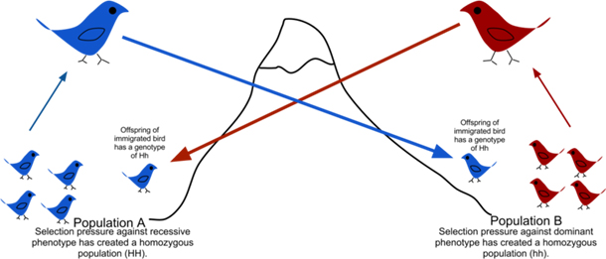
Migration of a section of population to a new place and formation of new population occurs

Slide 71
Natural selection
Natural selection is a process in which heritable variations enabling better survival are enabled to reproduce and leave greater number of progeny.
Experimental proof
Microbial experiments show that pre-existing advantageous mutations when selected will result in observation of new phenotypes.Over few generations, selected mutations would result in Speciation.
Conclusion
A critical analysis makes us believe that variation due to mutation or variation due to recombination during gametogenesis, or due to gene flow or genetic drift results in changed frequency of genes and alleles in future generation.

Slide 72
Operation of natural selection
Natural selection can lead to (i.e effect of natural selection)
stabilisation (more individuals acquire mean character value),
directional change (more individuals acquire value other than the mean character value) or
disruption (more individuals acquire peripheral character value at both ends of the distribution curve) .

Slide 73
Distribution curve of the operation of natural selection on different traits
Standard distribution of a trait across a population

Slide 74
Distribution curve of the operation of natural selection on different traits
Stabilising
(more individuals acquire mean character value)

Slide 75
Distribution curve of the operation of natural selection on different traits
Directional
(more individuals acquire value other than the mean character value)

Slide 76
Distribution curve of the operation of natural selection on different traits
Disruptive
(more individuals acquire peripheral character value at both ends of the distribution curve)

Slide 77
A BRIEF ACCOUNT OF EVOLUTION
Read the section 7.8 (pages: 137-140) and write a summary on
Evolution of plant and
Evolution of animals

Slide 78
A BRIEF ACCOUNT OF EVOLUTION
Sea weeds and few plants existed
Dinosaurs suddenly disappeared
Formation of active invertebrates
Million years ago | 2000 | 500 | 350 | 320 | 200 | 65
First cellular forms of life appeared
Reptiles dominated the earth (Example Tyrannosaurus rex).
Reptiles went back into water to evolve into fish like reptiles (e.g. Ichthyosaurs,)
Jawless fish probably evolved.
Fish with stout and strong fins could move on land and go back to water.

Slide 79
Ichthyosaurs

Slide 80
Tyrannosaurus rex was about 20 feet in height
Had huge fearsome dagger like teeth

Slide 81
Why did all dinosaurs become extinct?
Disappearance of dinosaurs may be due to;
Some say climatic changes killed them.
Some say most of them evolved into birds.

Slide 82
How non-cellular macromolecules could evolved into membranous cells?
The mechanism of how non-cellular aggregates of giant macromolecules could evolve into cells with membranous envelop is not known.
Some of these cells had the ability to release O₂.
The reaction could have been similar to the light reaction in photosynthesis where water is split with the help of solar energy captured and channelised by appropriate light harvesting pigments.
Slowly single-celled organisms became multi-cellular life forms.

Slide 83
Coelacanth- a lobefins
In 1938, Coelacanth (a fish) was caught in South Africa was thought to be extinct.
lobefins were the first amphibians and ancestors of modern day frogs and salamanders.
The amphibians evolved into reptiles. They lay thick shelled eggs which do not dry up in sun unlike those of amphibians.
Gradually, turtles, tortoises and crocodiles were evolved.

Slide 84
Salamanders

Slide 85
A BRIEF ACCOUNT OF EVOLUTION
The first mammals were like shrews. Their fossils are small sized.
Mammals were viviparous and protected their unborn young inside the mother’s body.
Mammals were more intelligent in sensing and avoiding danger at least.
When reptiles came down mammals took over this earth.
There were in South America mammals resembling horse, hippopotamus, bear, rabbit, etc.
Due to continental drift, when South America joined North America, these animals were overridden by North American fauna.
Due to the same continental drift pouched mammals of Australia survived because of lack of competition from any other mammal.
Some mammals live wholly in water. Example; Whales, dolphins, seals and sea cows.
Evolution of horse, elephant, dog, etc., are special stories of evolution.
The most successful story is the evolution of man with language skills and self-consciousness.

Slide 86
Shrews

Slide 87
ORIGIN AND EVOLUTION OF MAN
Time of origin | Human ancestors | General features/Facts
15 mya | Dryopithecus | hairy and walked like gorillas and chimpanzees, more ape-like
15 mya | Ramapithecus | hairy and walked like gorillas and chimpanzees, more man-like
2 mya | Australopithecines | probably lived in East African grasslands, hunted with stone weapons but essentially ate fruit
 | Homo habilis | first human-like being the hominid, brain capacities were between 650-800cc, probably did not eat meat
1.5 mya | Homo erectus (Java man) | large brain around 900cc, ate meat
1,00,000- 40,000 years back | Neanderthal man | Brain size of 1400cc, lived in near east and central Asia. They used hides to protect their body and buried their dead.
75,000-10,000 years ago (ice age) | Homo sapiens (Modern man) | Arose in Africa and moved across continents and developed into distinct races

Slide 88
EVOLUTION OF MAN
Few fossils of man-like bones have been discovered in Ethiopia and Tanzania revealed hominid features. These fossils lead to the belief that about 3-4 mya, man-like primates walked in eastern Africa.
They were probably smaller than 4 feet but walked up right.
Pre-historic cave art developed about 18,000 years ago.
Agriculture came around 10,000 years back and human settlements started.

Slide 89
Comparative Anatomical And Morphological as an evidence for Evolution
Comparative anatomy and morphology shows similarities and differences among organisms of today and those that existed years ago.
Similarities or differences of anatomy and morphology can be interpreted to understand whether common ancestors were shared or not.
Divergent evolution lead to development of homologous structures/organs.
Divergent evolution is development of different structures due to different needs for adaptations.

